Slide 1
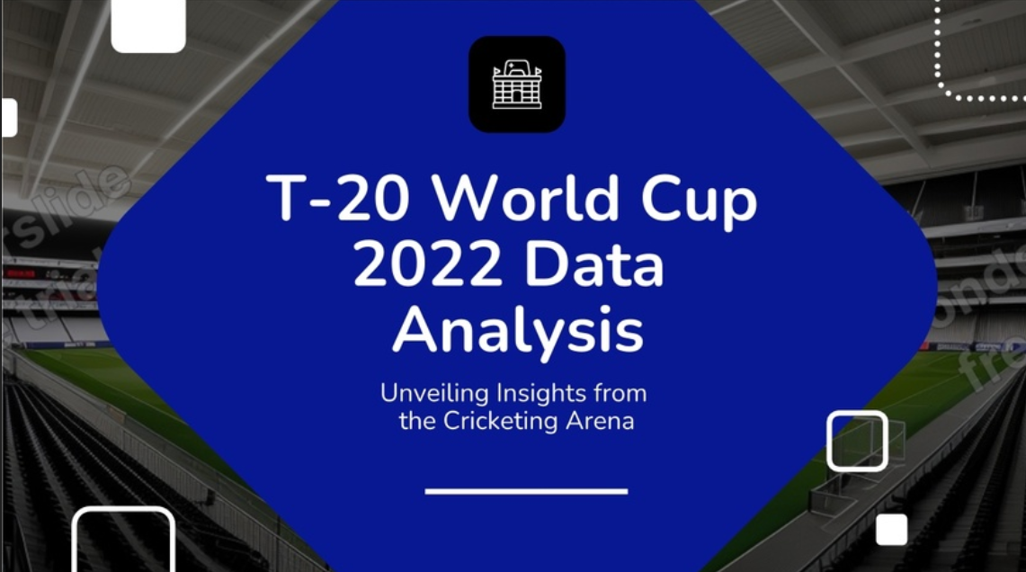

Slide 2

Introduction
Welcome to the T-20 World Cup 2022 Data Science project. In this endeavor, we'll embark on an exciting journey of comprehensive data analysis, drawing meaningful insights from the action-packed world of T20 cricket. We'll dive deep into the dataset, explore the nuances of the game, and provide valuable insights and inferences.

Slide 3
Mission
Data Exploration
In Depth Analysis
Event Inference
Performance Evaluation
Statistical Insights

Slide 4
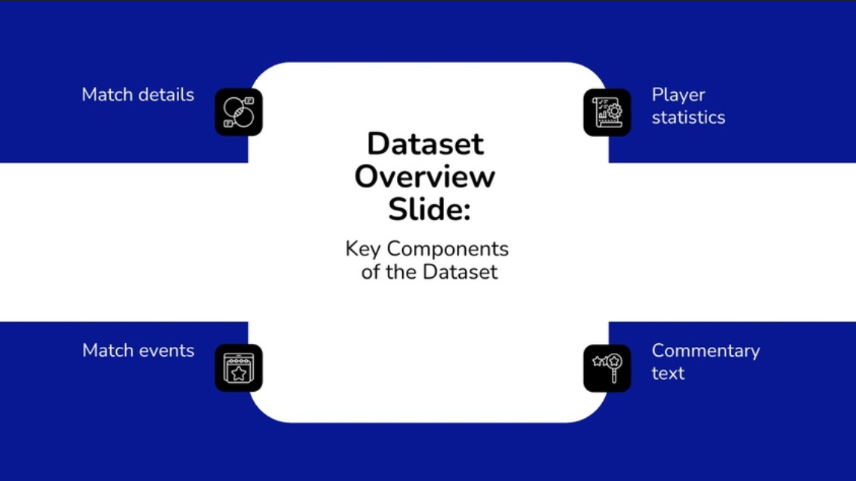

Slide 5
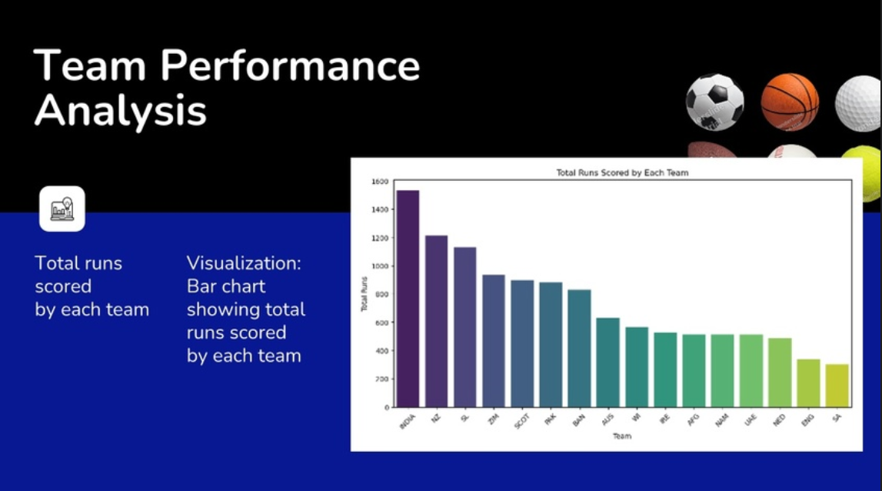
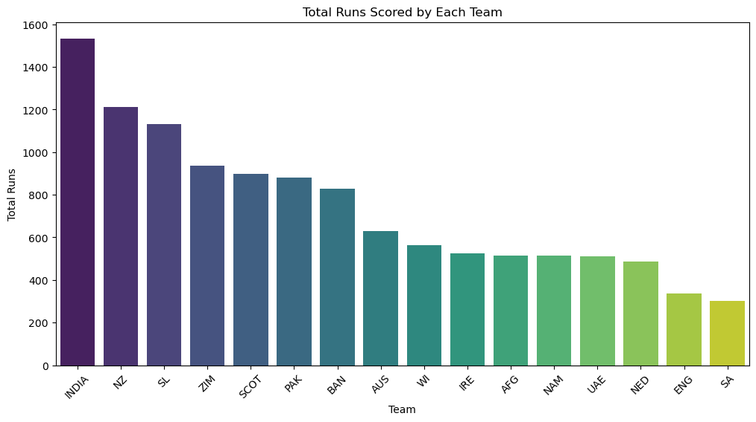

Slide 6
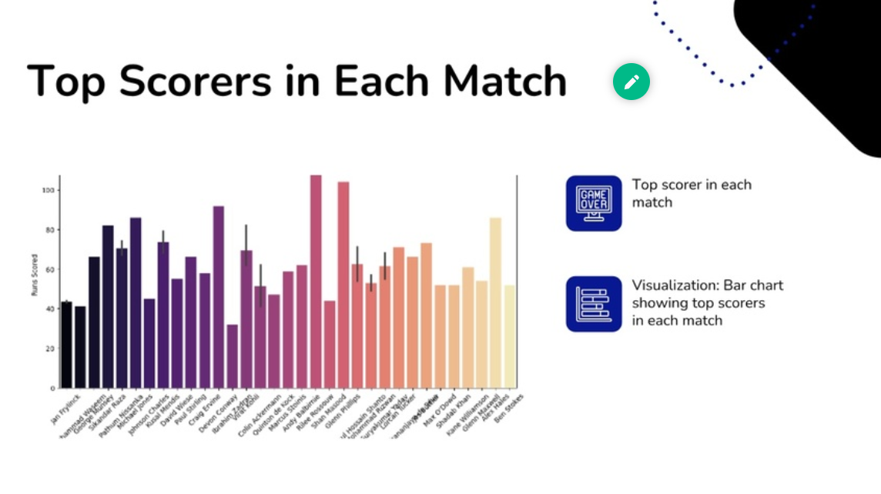
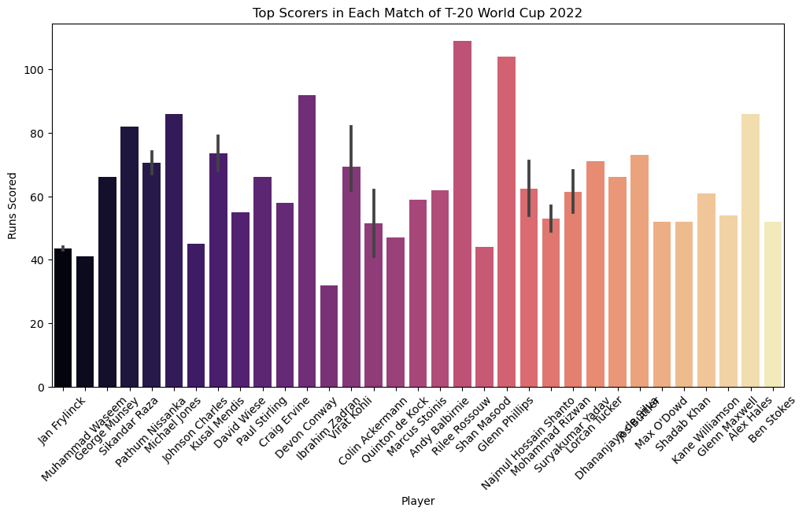

Slide 7
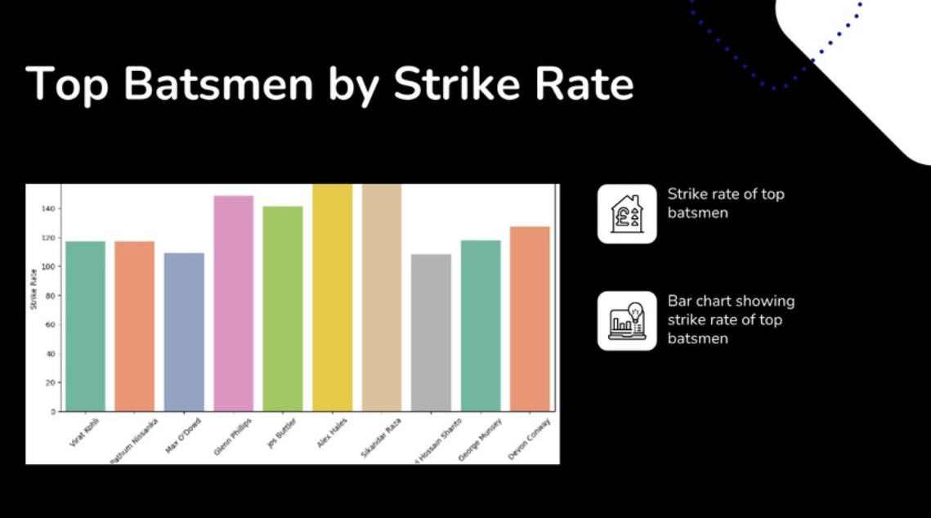
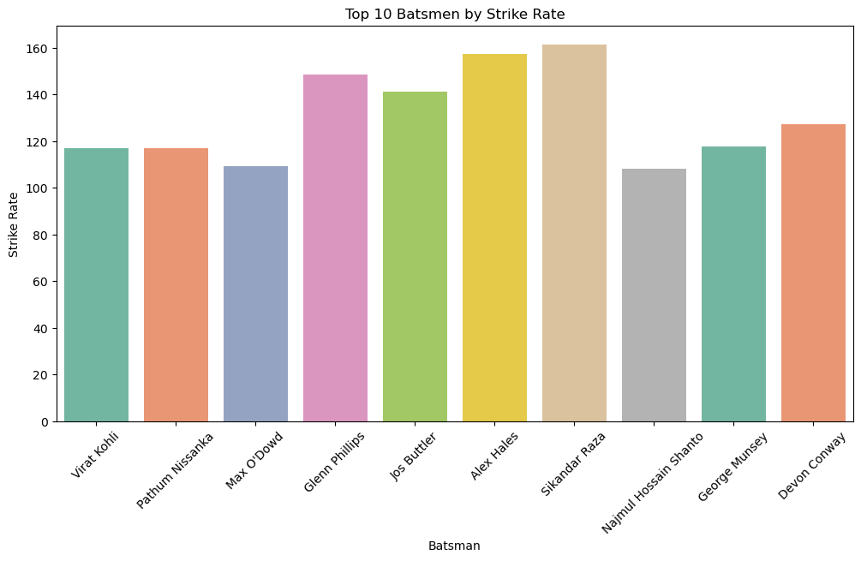

Slide 8
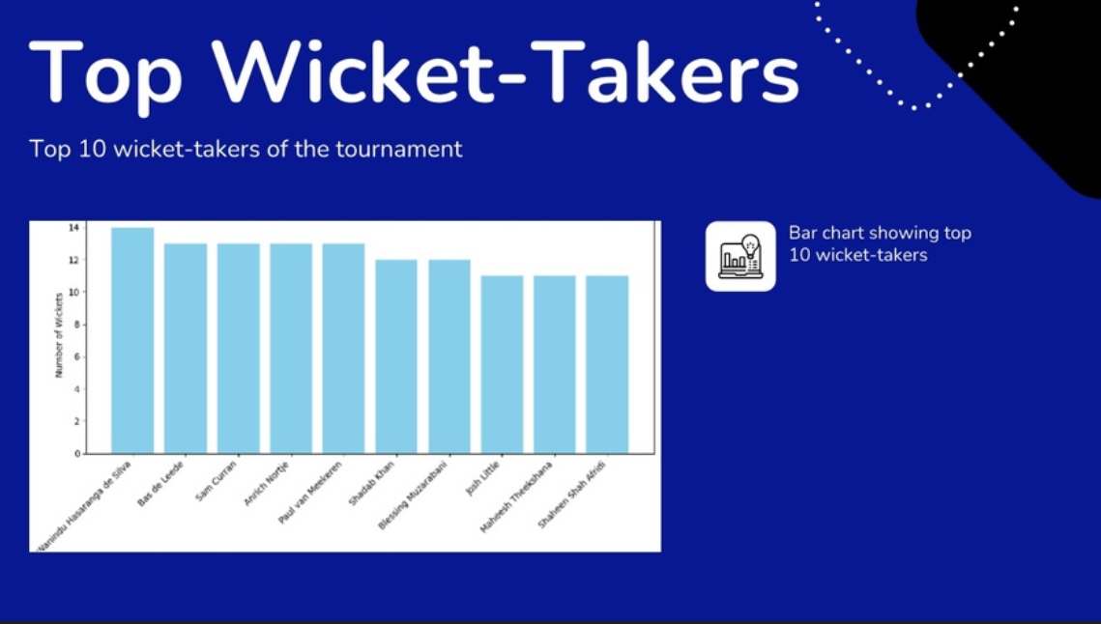
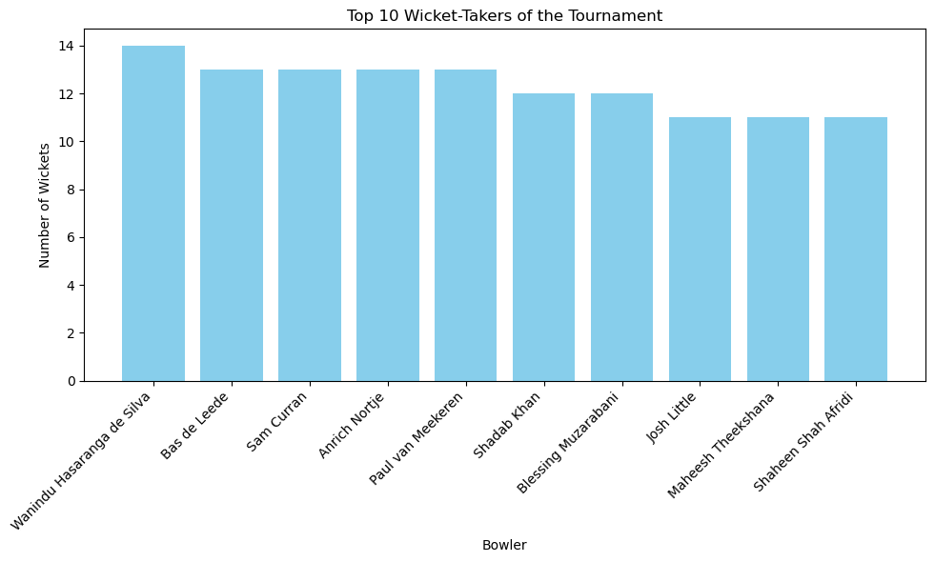

Slide 9
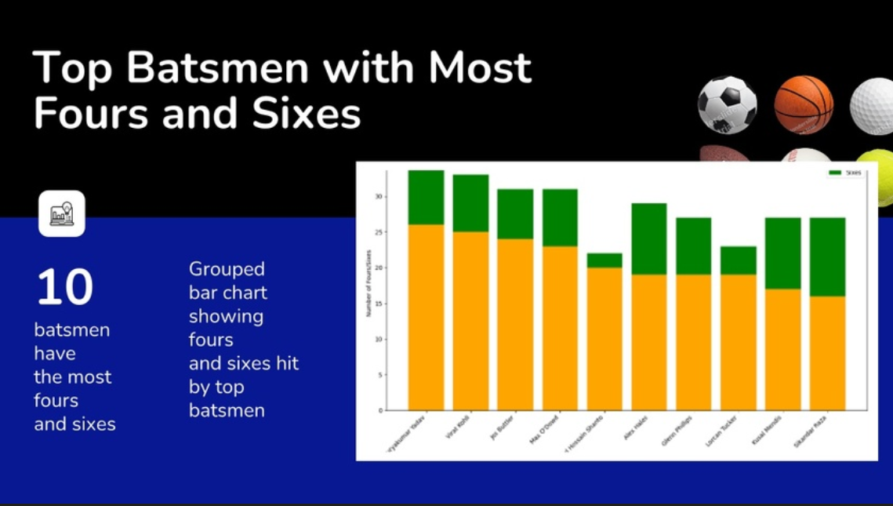
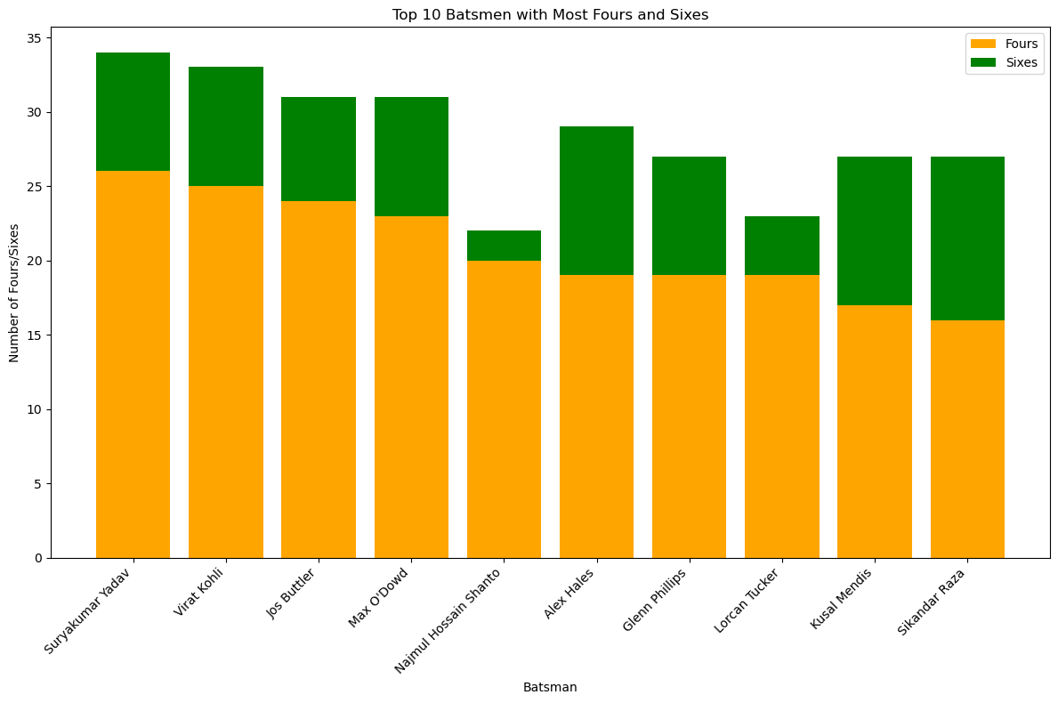

Slide 10
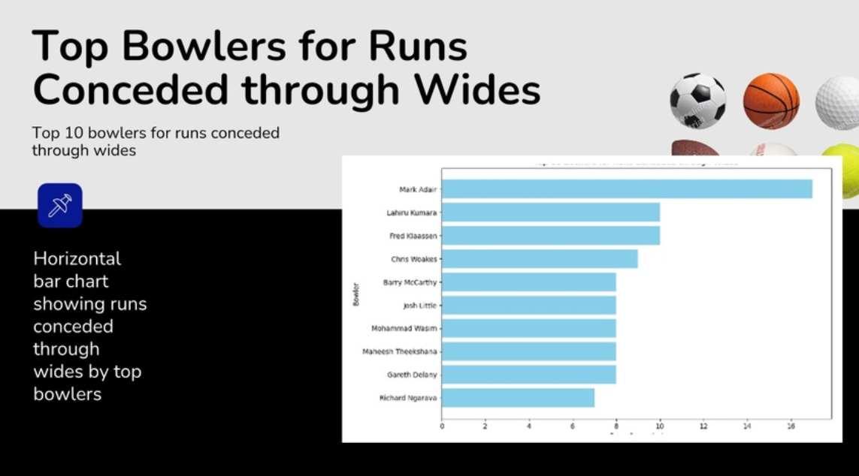
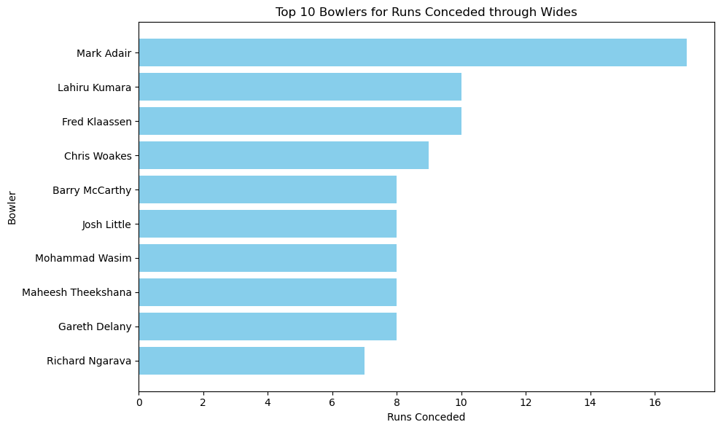

Slide 11
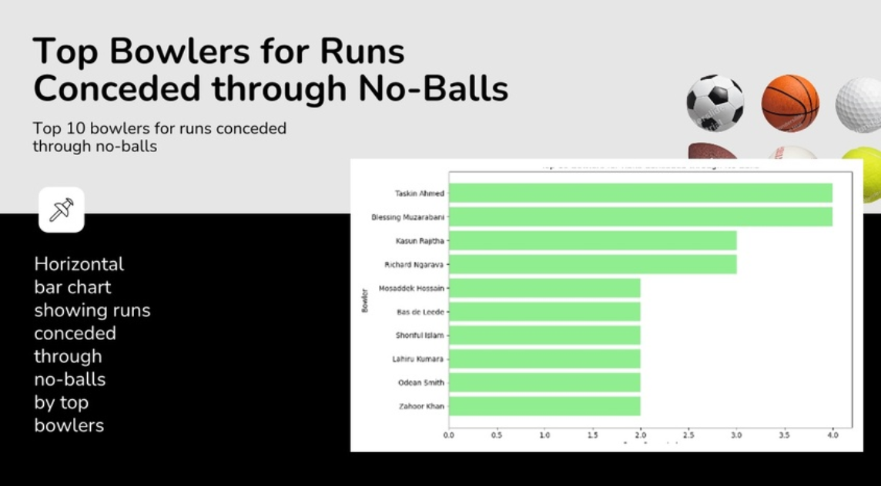
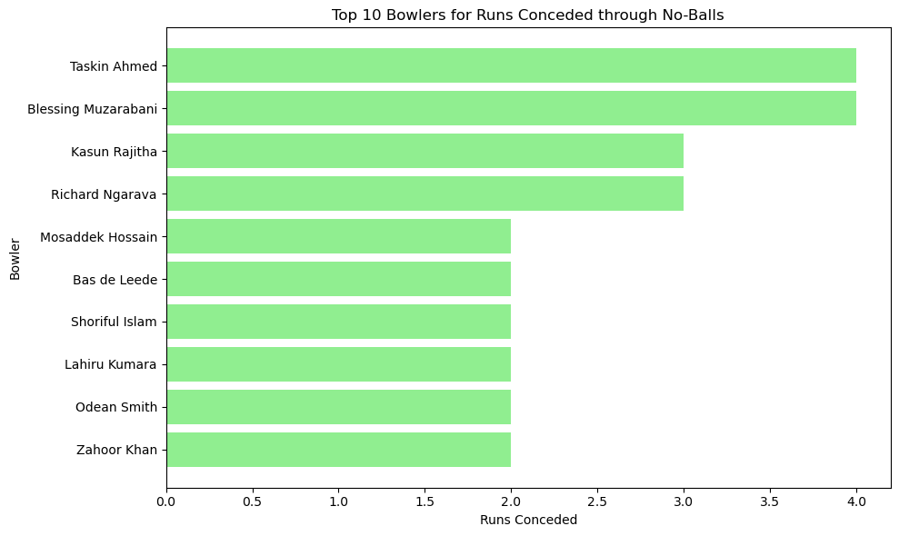

Slide 12
Thank You

